Slide 1

Epilepsy & Interface Design
Ensuring digital accessibility through research-driven guidelines and safety-first visual design strategies.

Slide 2

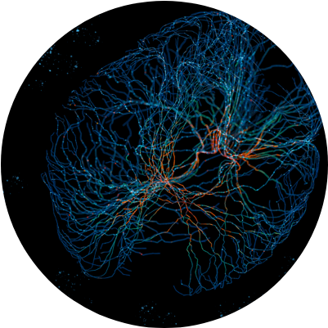
What is Photosensitive Epilepsy?
Neurological Response
Photosensitive epilepsy is a condition where seizures are triggered by flickering lights, high-contrast patterns, or specific frequencies of visual stimuli.
In digital environments, this poses a "safety-critical" challenge for UX/UI designers who must avoid creating hazardous visual content.

Slide 3


Triggers in Modern Interfaces
Flicker & Flash
Contrast & Patterns
Rapid changes in luminance or color intensity between 3Hz and 30Hz are primary triggers found in autoplay videos and flashing ads.
Repetitive geometric shapes, such as high-contrast stripes or "optical illusion" patterns, can induce cortical overstimulation.

Slide 4
Fisher et al. Research (2005)
Critical Frequency: Identifies the 3Hz to 30Hz range as the highest risk zone for seizure induction.
The "Three Flashes" Rule: No part of the screen should flash more than 3 times in one second.
User Agency: Emphasizes that dynamic web content must include user-controlled toggles to disable movement.

Slide 5
Harding & Harding Research (2010)
Luminance Impact: Found that brightness transitions are as dangerous as the frequency of the flashes.
Screen Area Correlation: The risk increases significantly if the flashing content occupies a large percentage of the user's field of view.
Technical Safeguards: Proposed automated scanning tools to detect hazardous sequences during UI development.

Slide 6






Design Guidelines for Safety
Manual Autoplay
Lower Saturation
Pattern Safety
Always disable autoplay by default. Allow users to initiate movement manually to avoid unexpected triggers.
Reduce high-contrast transitions. Use gradual fade-ins instead of instantaneous flashing transitions.
Avoid narrow, repetitive stripes or high-frequency geometric grids that occupy more than 25% of the screen.

Slide 7

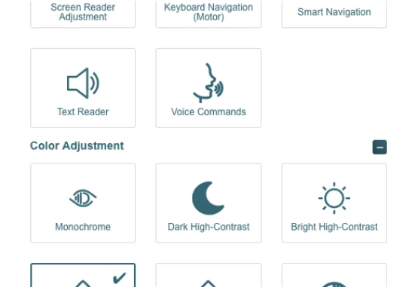
Case Study: accessiBe UI Overlay
Seizure Safe Profile
The accessiBe "Seizure Safe" profile is a dedicated mode designed to neutralize visual hazards instantly.
It acts as a real-time filter between the raw web content and the user's perception, ensuring compliance with research-backed safety standards.

Slide 8
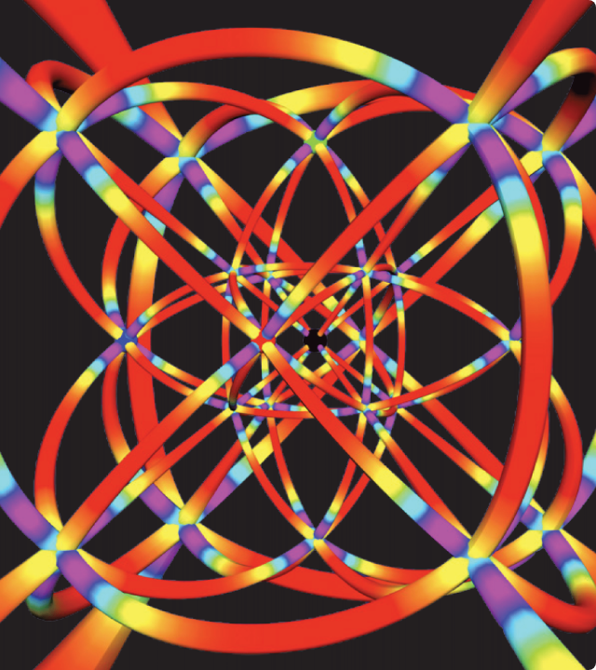
Animation Suppression
Freeze Motion Technology
This interface feature immediately pauses all GIFs, CSS animations, and looping videos with a single toggle.
By eliminating the "flicker" at the source, it reduces the risk of seizures from unpredictable web advertisements and decorative animations.

Slide 9

Analysis Tool: PEAT Analysis
Automated Verification
The Photosensitive Epilepsy Analysis Tool (PEAT) allows developers to capture screen video and analyze it for potential seizure triggers.
It checks for luminance, red-flash frequency, and screen area coverage to ensure every update is safe before deployment.

Slide 10

Strategic Design
Safety is Non-Negotiable
By implementing the "Three Flashes" rule and providing suppression tools, we ensure that digital interfaces are physically safe.
Designing for epilepsy improves UX for everyone by reducing visual noise and creating more intentional interactions.

Slide 11

Questions?
Ensuring accessibility through inclusive and safe design.
Topic: Photosensitive Epilepsy in UI Design
Research: Harding & Harding | Fisher et al.
Presentation By: Talha Naveed (089) & Abdul Wahab (007)

